Slide 1

Analyzing Axon’s Sales
SQL CASE STUDY ON AXON SALES
AUTHOR : ROHAN SHRUNGARE

Slide 2

TABLE OF CONTENTS
🔹 Slide 1 – SQL Case Study & Author 🔹 Slide 2 – Table of Contents 🔹 Slide 3 – Introduction & About Axon 🔹 Slide 4 – Problem Statement: Challenges in Sales Management 🔹 Slide 5 – Understanding MySQL Database Schema 🔹 Slide 6 – Entity Relationship Diagram (ERD) 🔹 Slide 7 – Key Business Metrics 🔹 Slides 8-17 – SQL Case Study: Queries & Solutions 🔹 Slides 18-19 – Key Insights from Data Analysis 🔹 Slide 20 – Strategic Recommendations for Axon 🔹 Slide 21 – Thank You! (GitHub & LinkedIn References)

Slide 3
AXON: A PREMIER RETAILER OF CLASSIC CARS
Introduction to Axon
Axon is a well-established company specializing in high-quality collectible models, catering to enthusiasts and collectors worldwide. The company offers a diverse range of products, including Classic Cars, Motorcycles, Trains, Ships, Planes, Trucks & Buses, and Vintage Cars.
About the Company
Axon is known for its commitment to excellence, ensuring top-tier product quality and exceptional customer service. The company has built strong relationships with trusted vendors and suppliers to maintain a steady product supply. With a customer-centric approach, Axon focuses on efficient order management, timely deliveries, and seamless transactions. Its growing market presence and data-driven strategies enable sustainable growth and continuous expansion into new regions

Slide 4

CHALLENGES IN SALES DATA MANAGEMENT AT AXON
Axon lacks a centralized system to manage and store its sales data, leading to inefficiencies in data retrieval and analysis.
The sales team struggles to generate accurate, up-to-date reports, impacting their ability to make informed decisions.
There is no streamlined process for tracking sales performance and customer insights, hindering the optimization of sales strategies.
The management team is unable to access real-time sales data, affecting timely decision-making and strategic planning.
The absence of an integrated system for data analysis
and reporting limits the company’s ability to forecast future sales trends effectively.

Slide 5
Overview of MySQL Sample Database Schema
The MySQL sample database schema consists of the following 8 tables, each designed to store specific data relevant to the retail business:
Customers: Stores customer data, including personal information and contact details.
Products: Stores a list of scale model cars available for sale.
Product Lines: Stores a list of product line categories that group the products.
Orders: Stores sales orders placed by customers, capturing order details and status.
Order Details: Stores sales order line items, detailing the individual products in each order.
Payments: Stores records of payments made by customers for their purchases.
Employees: Stores employee information, including organizational structure and reporting hierarchy.
Offices: Stores sales office data, including locations and office-related details.

Slide 6
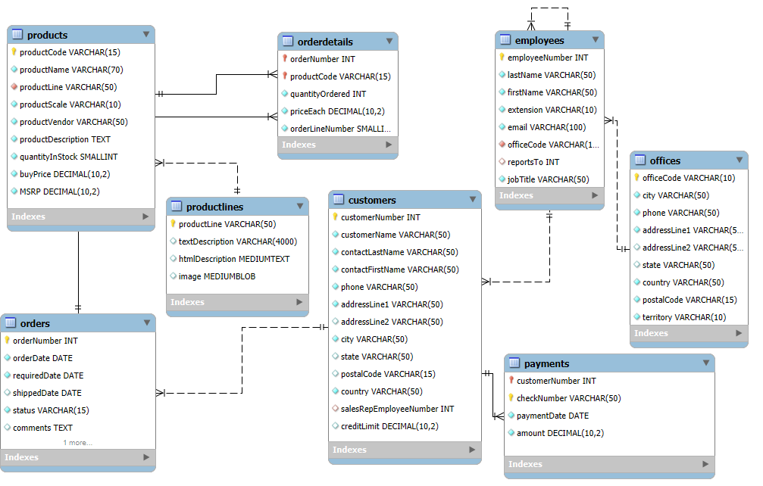
Entity-Relationship Diagram of MySQL Sample Database

Slide 7

Key Business Metrics Overview
Total Customers
122
Revenue
96,04,190
Total No of Orders
326
Types of Products
1.Classic cars
2.MotorCycles
3.Planes
4.Ships
5.Trains
6.Trucks and Buses
7.Vintage Cars
Average Delivery Days
4 DAYS
Products
7
Best Selling Product
1992 Ferrari 360 Spider Red

Slide 8
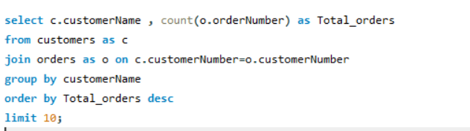
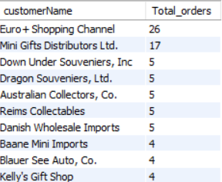
Customers with the Highest Number of Products Purchased

Slide 9
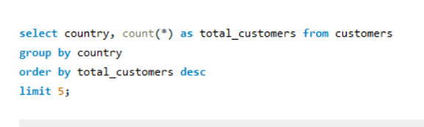
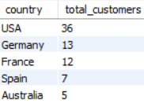
Where Are the Majority of Our Customers Located?

Slide 10
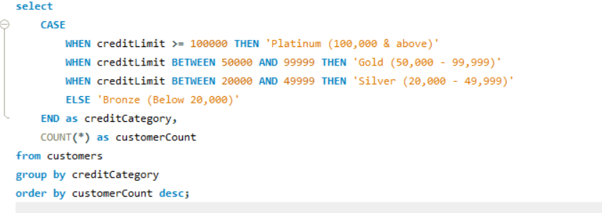
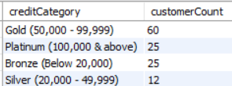
How Are Customers Categorized Based on Their Credit Limits?

Slide 11
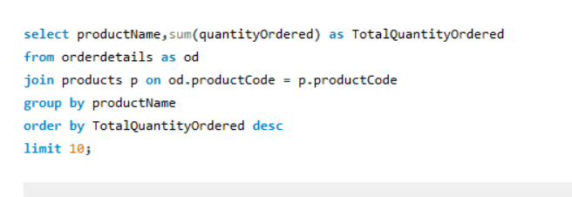
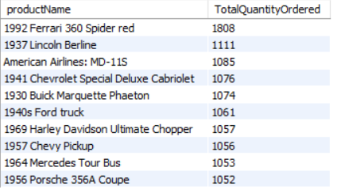
Top 10 Best-Selling Products by Quantity Ordered

Slide 12
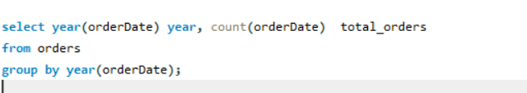
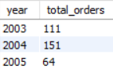
Tracking the Number of Orders Placed Annually

Slide 13
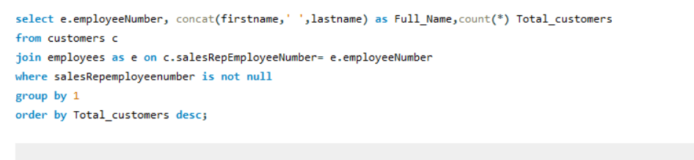
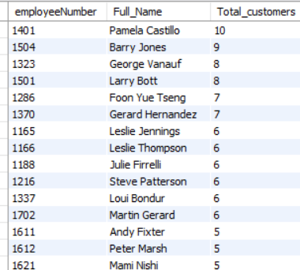
How Many Customers Does Each Sales Representative Handle?

Slide 14
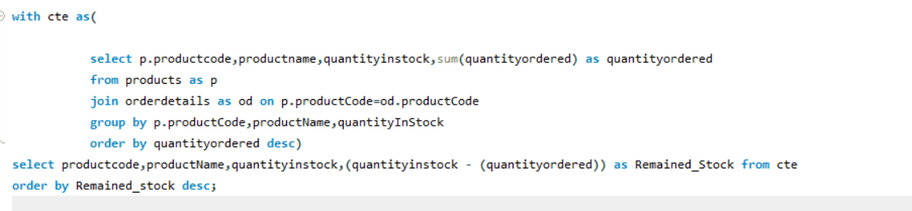
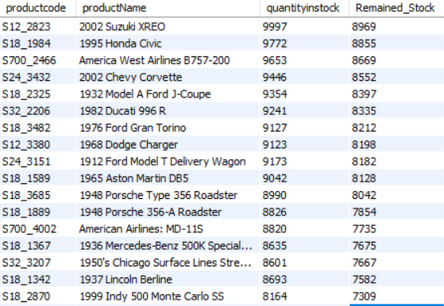
Could you show the product-wise inventory remaining in the Classic warehouse?

Slide 15
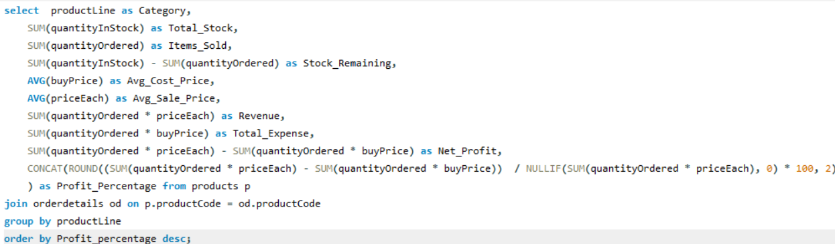
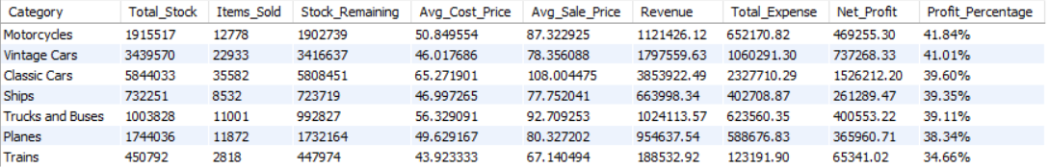
Product-wise Profit Margin Report

Slide 16
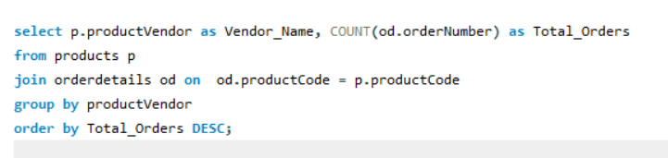
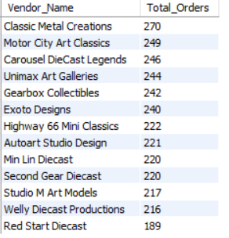
Number of Products Ordered per Vendor

Slide 17
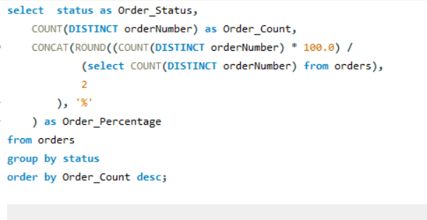
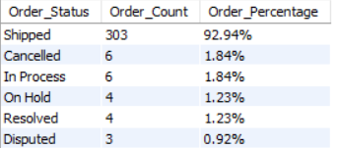
What is the breakdown of orders by their delivery status, including count and percentage?

Slide 18
Key Insights from Axon Case Study
1. Top Customers by Purchases
Euro + Shopping Channel leads with 26 orders, followed by Mini Gifts Distributors Ltd with 17 orders, indicating key repeat customers.
2. Customer Location Distribution
USA has the highest number of customers (36), followed by Germany (13) and France (12), showcasing strong market presence in North America and Europe.
3. Customer Segmentation by Credit Limit
60 customers are categorized as Gold ($50,000 - $99,999), representing the largest customer segment by credit limit, with 25 customers in both Bronze and Platinum categories.
4. Top 10 Best-Selling Products by Quantity
The 1992 Ferrari 360 Spider Red leads with 1,808 units sold, followed by 1937 Lincoln Berlin (1,111 units) and American Airlines MD-11 (1,085 units), reflecting strong sales across multiple product lines.
5. Orders by Year
The highest volume of orders was in 2004 with 151 orders, showcasing a peak in sales activity that year.

Slide 19
6. Inventory Management
Some products exhibit negative remaining stock, suggesting potential over-sales or stock mismanagement, warranting further investigation to optimize inventory levels.
7. Profit Margins by Category
Motorcycles & Vintage Cars have the highest profit margin at 41%, followed by Classic Cars, Ships, Trucks & Buses at 39%, and Planes at 38%.
8. Orders Per Vendor
Classic Metal Creations leads with 270 orders, followed by Motor City Arty Classic (249 orders) and Carousel Diecast Legends (246 orders), reflecting strong vendor partnerships and product availability.
9. Order Status Breakdown
92.94% of orders were shipped, with only a small percentage in canceled or disputed statuses, indicating high order fulfillment efficiency.

Slide 20
Strategic Recommendations for Axon’s Growth
Optimize Inventory Management: Address negative stock issues and implement demand forecasting to prevent over-sales.
Focus on High-Margin Products: Expand offerings in high-margin categories like Motorcycles and Vintage Cars to maximize profits.
Improve Delivery Times: Explore logistics optimization to reduce the average delivery time and enhance customer satisfaction.
Target High-Value Customers: Focus marketing efforts on the Gold and Platinum customer segments for better sales growth.
Enhance Vendor Partnerships: Strengthen relationships with top vendors like Classic Metal Creations to ensure steady product supply.
Expand in Key Markets: Invest in marketing strategies targeting regions with high customer density like the USA and Germany.
Improve Order Fulfillment: Streamline the order management process to reduce cancellations and disputed orders

Slide 21

THANK YOU..!

